Slide 1
Lending Club Case Study
P. Sai Santhosh

Slide 2
Problem Statement
This company is the largest online loan marketplace, facilitating personal loans, business loans, and financing of medical procedures. Borrowers can easily access lower interest rate loans through a fast online interface.
The company wants to understand the driving factors behind loan default.
The company wants to understand the driving factors (or driver variables) behind loan default, i.e. the variables which are strong indicators of default. The company can utilise this knowledge for its portfolio and risk assessment.

Slide 3
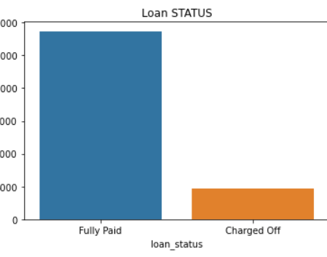
Analysis of Each field with another field so that we can come to conclusions
Defaulters can be obtained by filtering the Loan status by giving Charged off so that we will get the Defaulters.
We have to Do the Risk Analysis on Defaulters so that we can compare them with other factors and get to a conclusion.

Slide 4
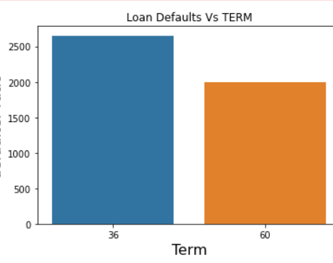
Defaulters Vs Term
From the Bar Plot we can infer that,
If the term for certain amount is less then there is high chance of Neglecting the loan so based on the salary the term should be calculated

Slide 5
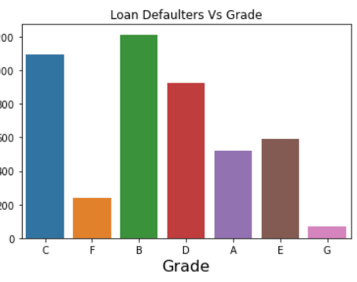
Loan Defaluters Vs Grade
From the Plot we can get a conclusion that
If grades are more then getting loan is easy
Where as in other cases we customer has high probability of not getting Loan
We can get conclusion from this Field

Slide 6
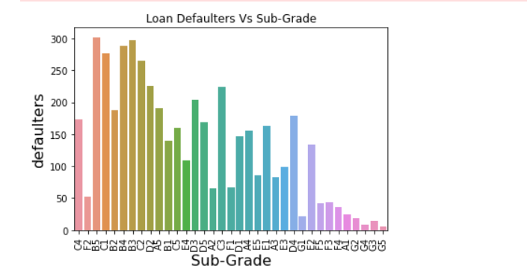
Loan Defaluters Vs Sub Grade
From the Plot We can infer that,
There is no proper conclusion obtained from this field as the data is very uneven in this case

Slide 7
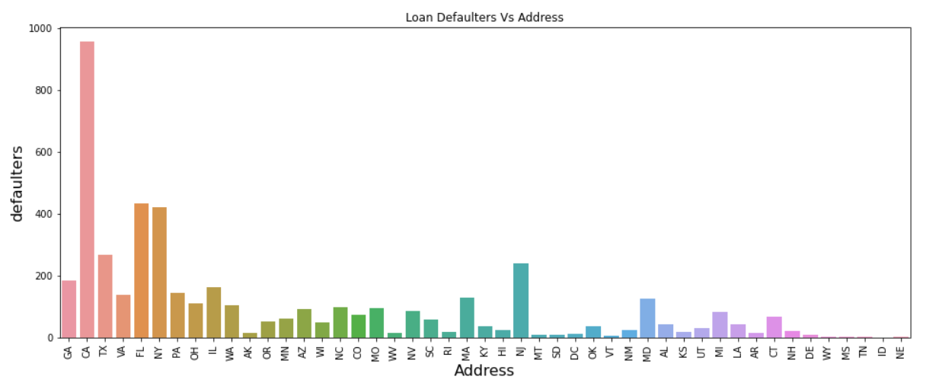
Defaulters Vs Address
From the plot, WE Can tell that apatrt from one to fields we can give loans as the risk is less in that fields

Slide 8
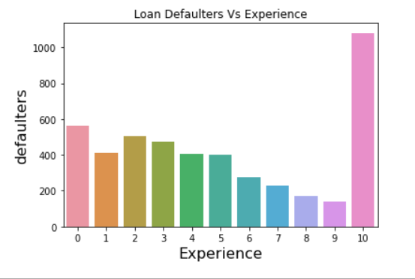
Defaluters Vs Experience
As the Experience increases the risk of Defaulting the loan is reduced but if the person have more than 10 experience then he can be given loan
We can get an conclusion from this Plot

Slide 9
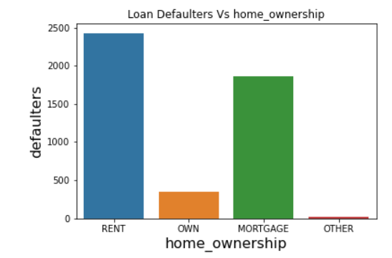
Defaulters Vs Home Ownership
From the plot we can infer that, if the member have any own property then he can be given loan and his repayments are also good where as in other case, its better to consider other factors also and decide
We can conclude from this field

Slide 10
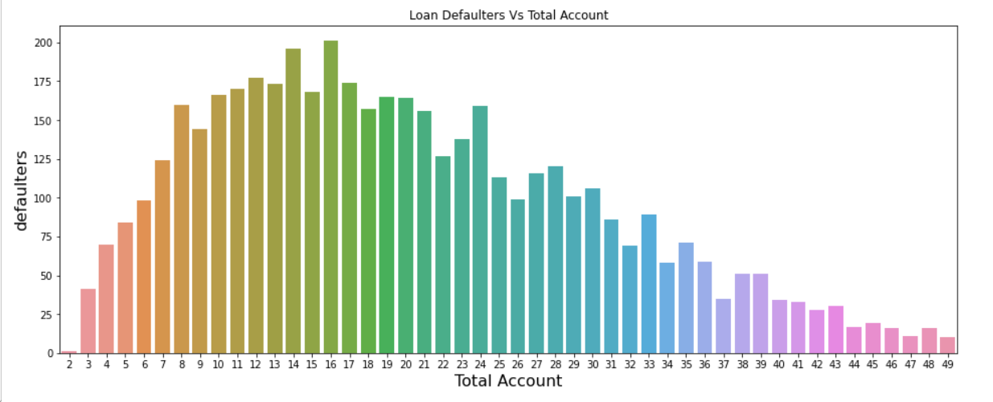
Defaulters VS Total Accounts
From the Plot, We can infer that a person having an account from range 8- 30, There is high chance that they can default the loan so its better if we reject them
We can conclude from this field

Slide 11
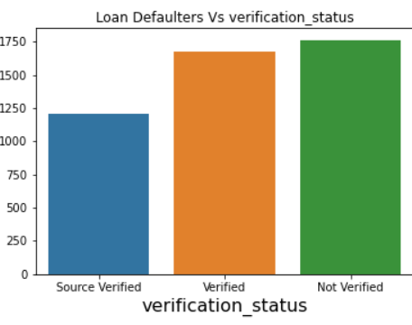
Defaulter VS Verification Status
From Bar chart we can analyse that, there is no much difference between being a defaulter or no.
We cannot conclude from this field

Slide 12
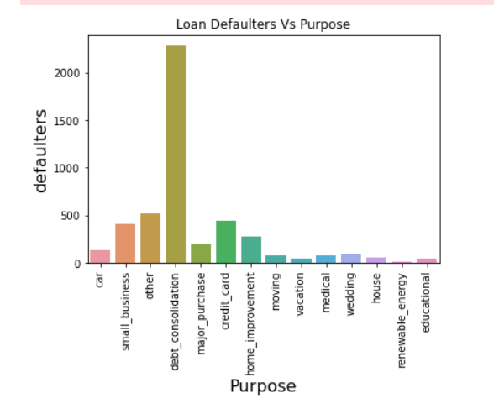
Defaulter Vs Purpose
We can conclude from the bar chart that
Apart from all the reasons, Debt consolidation is the purpose then the loan should be given
So we can get conclusion from this field

Slide 13
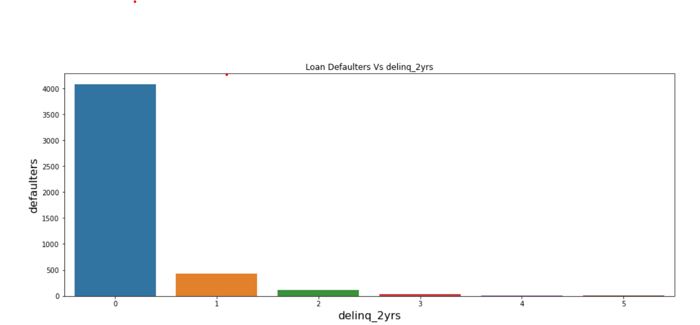
Defaulters Vs No of Late Payments
We can conclude from the bar chart that they are very less late payments by Defaulters compared to count of 0
So we cannot get any reference from this field

